Slide 1

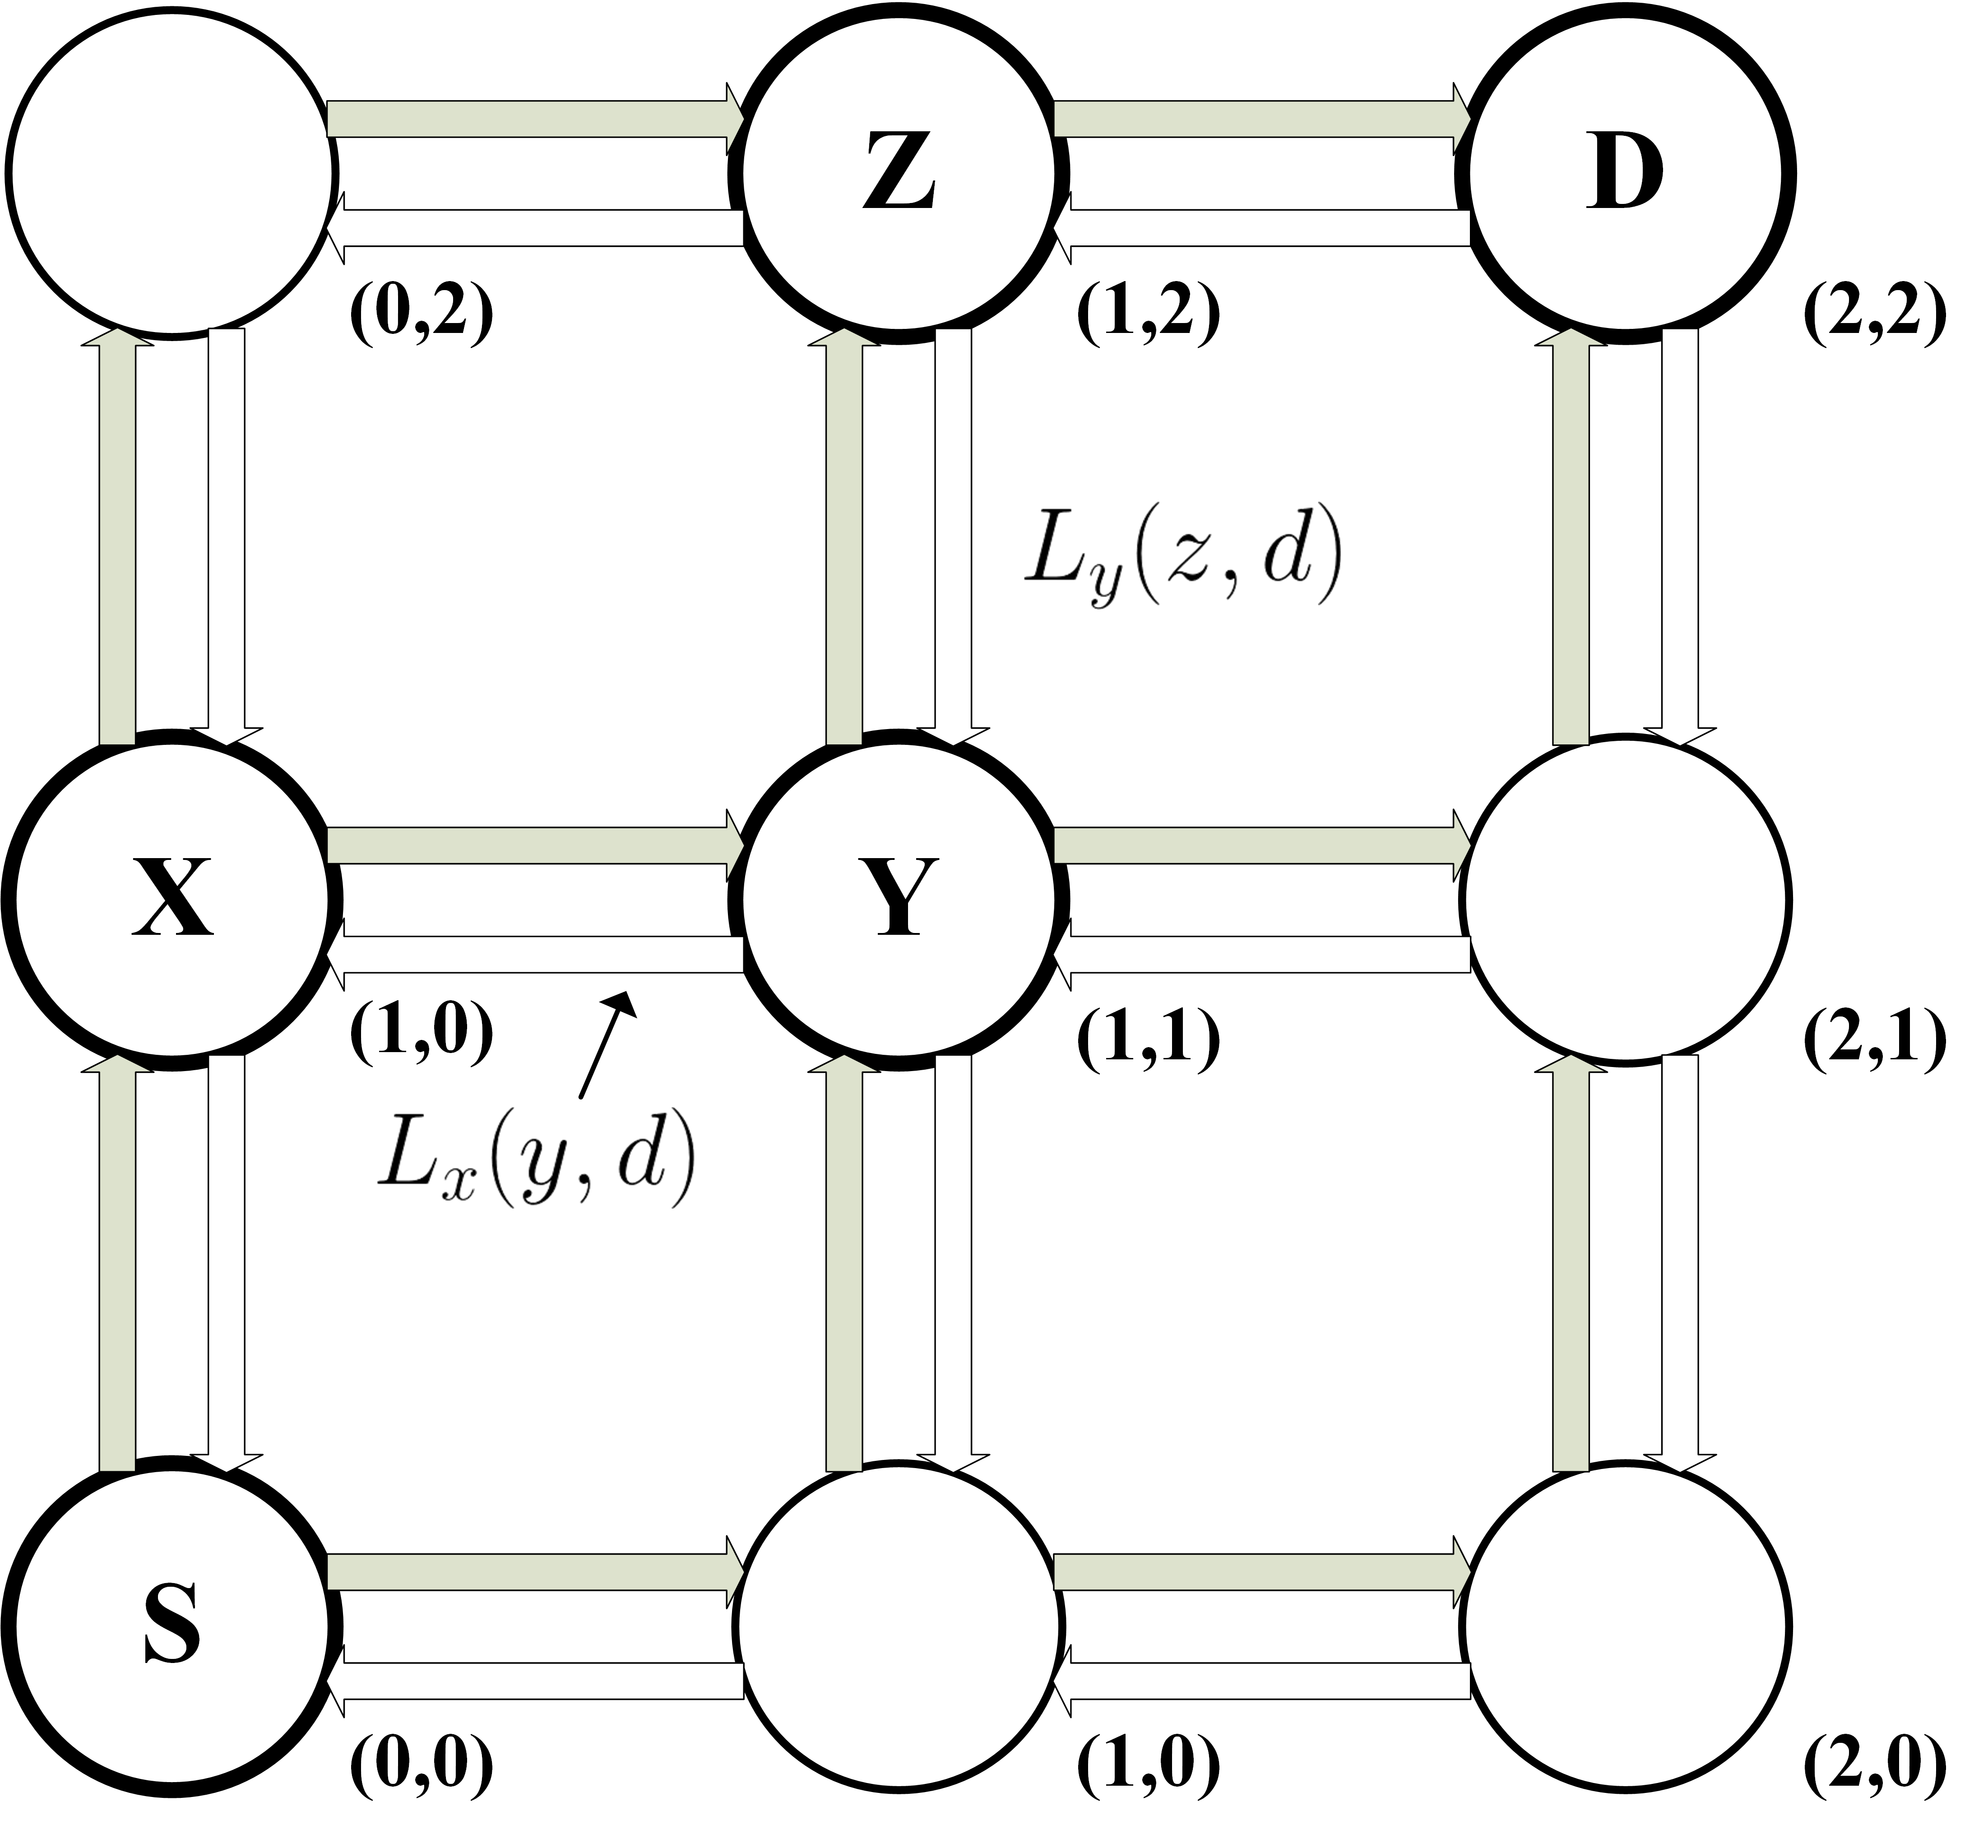
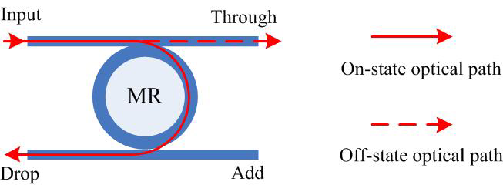
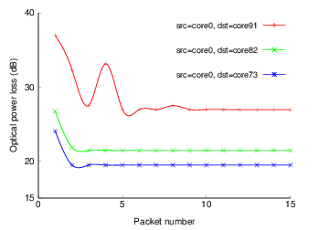
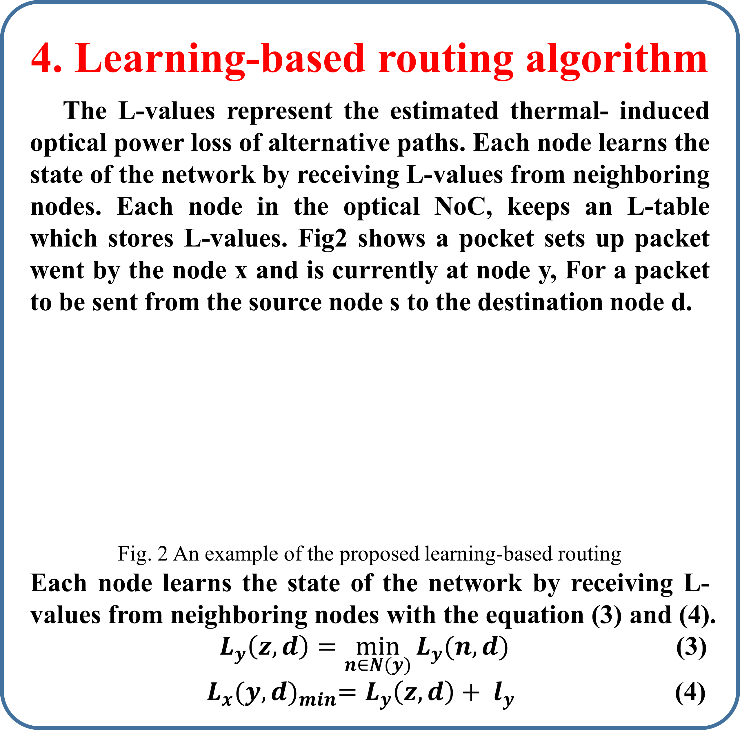
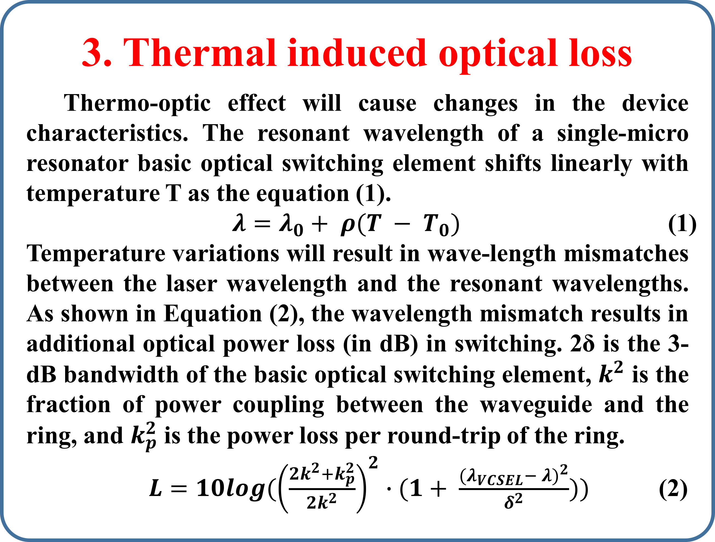
A Learning-Based Thermal-Sensitive Routing for
Power Optimization of Optical NoCs
NOCS 2018
Yaoyao Ye¹, Zhe Zhang¹, Renjie Yao¹, Weichen Liu²
¹Shanghai Jiao Tong University, Shanghai 200240, P. R. China.
²Nanyang Technological University, Singapore
Contact yeyaoyao@sjtu.com.cn
Abstract
Silicon photonic devices used in optical NoCs suffer from significant thermal-induced optical power loss. We propose a learning-based thermal-aware routing algorithm to find optimal shortest paths with the minimum estimated thermal-induced optical power loss according to runtime on-chip temperature distributions. Network simulations show that the learning-based routing algorithm is able to find an optimal path with the minimum estimated thermal-induced optical power loss for every communication pair.
4. Learning-based routing algorithm
The L-values represent the estimated thermal- induced optical power loss of alternative paths. Each node learns the state of the network by receiving L-values from neighboring nodes. Each node in the optical NoC, keeps an L-table which stores L-values. Fig2 shows a pocket sets up packet went by the node x and is currently at node y, For a packet to be sent from the source node s to the destination node d.
Fig. 2 An example of the proposed learning-based routing
Each node learns the state of the network by receiving L-values from neighboring nodes with the equation (3) and (4).
${ L}_{y}\left(z,d\right)=\min_{n∈N(y)}{L_{y}(n,d)}$ (3)
${ L}_{x}{(y,d)}_{min}=L_{y}\left(z,d\right)+ l_{y}$ (4)
2. Introduction
Optical interconnects can enable significantly increased bandwidth density, low power consumption, and low latency. Optical NoCs can overcome many of the most serious on-chip communication issues. However, wavelength-selective silicon photonic devices such as micro resonators suffer from temperature-dependent wavelength shifts .
Fig.1 Simplified model of a microresonator
In order to mitigate thermal effects, many other research have proposed many method from different levels, such as OS-based workload migration, thermal tuning on device-level solution, and some efforts from system-level perspe-ctives. Adaptive routing is another way to improve the re-liability of optical NoCs in presence of temperature vari-ations.
we propose a learning-based thermal-aware routing algorithm to find optimal paths with the minimum optical power loss.
5. Simulation result & comparisons
We developed a SystemC-based
cycle-accurate network simul-
ator for a 3D 8x8x2 torus-based
optical NoC with the proposed
learning-based routing algorit-
hm. First, we show the conver-
gence of the proposed learning
based thermal-aware at fig 3.
Second, fig 4 shows the comparisons of the normalized worst case thermal-induced optical energy efficiency among all packets in each real application. Fig 5 shows that the loss distribution is shifted to the low-loss regions by using the proposed learning-based thermal-aware routing.
algofigrithm on Fig 3.
3. Thermal induced optical loss
Thermo-optic effect will cause changes in the device characteristics. The resonant wavelength of a single-micro resonator basic optical switching element shifts linearly with temperature T as the equation (1).
$λ=λ_{0}+ ρ(T − T_{0})$ (1)
Temperature variations will result in wave-length mismatches between the laser wavelength and the resonant wavelengths. As shown in Equation (2), the wavelength mismatch results in additional optical power loss (in dB) in switching. 2δ is the 3-dB bandwidth of the basic optical switching element, $k^{2}$ is the fraction of power coupling between the waveguide and the ring, and $k_{p}^{2}$ is the power loss per round-trip of the ring.
$L=10log({\left(\frac{2k^{2}+k_{p}^{2}}{2k^{2}}\right)}^{2}∙(1+ \frac{{(λ_{VCSEL}− λ)}^{2}}{δ^{2}}))$ (2)
Fig.4 The worst-case thermal-induced optical
energy efficiency under real applications
Fig.5 The loss distribution of the SATELL
application
8. Conclusions
We proposed a learning-based thermal-aware routing algor-ithm to find optimal paths. Simulation results show that the average thermal-induced energy consumption is reduced by 76.1% and the worst-case thermal-induced energy cons-umption is reduced by 33.8% as compared to the XYZ routing.

